Slide 1
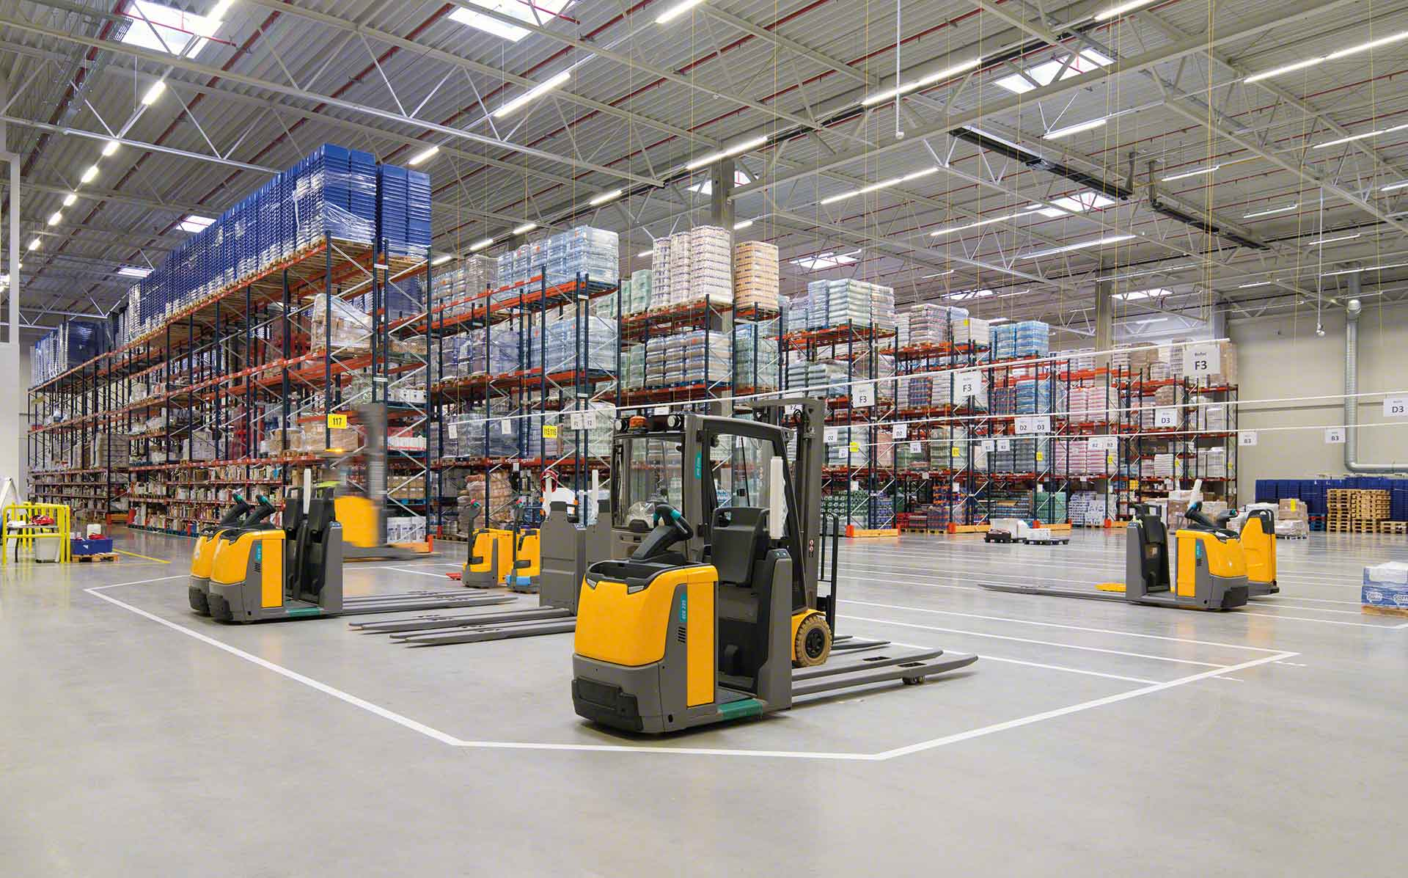

Material Handling KPI
Semana 1 octubre 2022

Slide 2
Movements November
User | Sum of CYCLE COUNTS | Sum of MAT HANDLE | Sum of cc MH
erojas | 0 | 330 | 330
amiranda | 0 | 268 | 268
judelato | 1 | 198 | 199
jtobias | 1 | 189 | 190
jodelacr | 2 | 19 | 21
Grand Total | 4 | 1004 | 1008
Weekly movements
1004

Slide 3
Adjustments
Row Labels | Sum of COST | Count of PART
jtobias | $104.75 | 1
judelato | $80.80 | 1
jodelacr | $25.26 | 2
Grand Total | $210.81 | 4
Adjustments difference
-$210.81

Slide 4
Labor intensive
Class not slotted count
10
Labor Intensive
33

Slide 5
restock
Part Numbers stocked
382

Slide 6
Empty locations
Week empty locations
309

Slide 7
Discrepancies
Date | Sum of Locaciones
29 Agosto- 2 Septiembre | 25
5 - 9 Septiembre | 15
12- 16 Septiembre | 15
26-30 Septiembre | 13
19-23 Septiembre | 10
3-7 Octubre | 5
Grand Total | 83
Total week discrepancies
5

Slide 8
Consolidation
Row Labels | 29 DE SEPTIEMBRE | 6 DE OCTUBRE
12313 | 9 | 9
38405 | 9 | 7
11103391 | 9 | 7
13213 | 8 | 7
1054267V01 | 8 | 7
37021 | 8 | 6
1054268V01 | 8 | 7
0185918 | 8 | 7
1088069V01 | 8 | 7
33082 | 8 | 8
70714 | 8 | 7
1024818 | 8 | 5
12211 | 8 | 7
0530096 | 8 | 5
13114 | 8 | 6
71067 | 7 | 4
39116 | 7 | 5
95305 | 7 | 4
36314 | 7 | 6
70716 | 7 | 2
Grand Total | 158 | 123
Total week consolidations
35

Slide 9
Distribution warehouse
Row Labels | Count of Item
01 - FASTENERS | 1388
10 - SAFETY SUPPLIES | 507
02 - TOOLS AND ACCESSORIES | 134
04 - HYDRAULICS AND PNEUMATICS | 108
06 - JANITORIAL SUPPLIES | 90
03 - CUTTING TOOLS | 80
15 - MFG Standards | 77
07 - ELECTRICAL SUPPLIES | 60
50 - CLEARANCE | 58
08 - Welding & Abrasives | 42
05 - MATERIAL HANDLING | 41
16 - Office Products | 34
95 - FASTENAL WORK WEAR | 23
97 - GENERAL SUPPLIES | 20
90 - PACKAGING MATERIAL | 12
99 - FASTENERS - SEMI-STANDARDS | 7
30 - SERVICE BANDSAW WELDING | 3
09 - MFG SPECIALS DIVISION | 3
33 - SERVICE REGRIND SHARPCUT | 2
14 - METALS-ALLOYS AND MATERIALS | 1
Grand Total | 2690

